Slide 1
^{Lot 3}
ITS Station Management Core – Low Level Description
Michelle WETTERWALD
03/04/2012

Slide 2
Summary
References
Section 6.5 L221
21/02/2012 Meeting Report
DriveC2X WP24 – Interface IF.MGMT.2
Content
Management High Level Schema
Management Core detailed Schema
Interfaces Description : GN-CM, FAC-CM, Path-MNGT, UMTS-CM, WIFI-CM
Language used : C++
Interfaces : Sockets UDP (address and ports in .conf files)

Slide 3
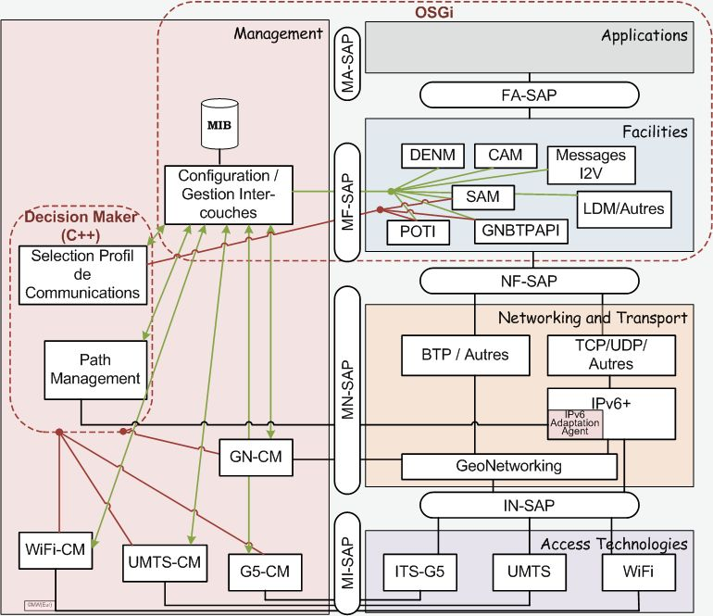
Global Schema

Slide 4
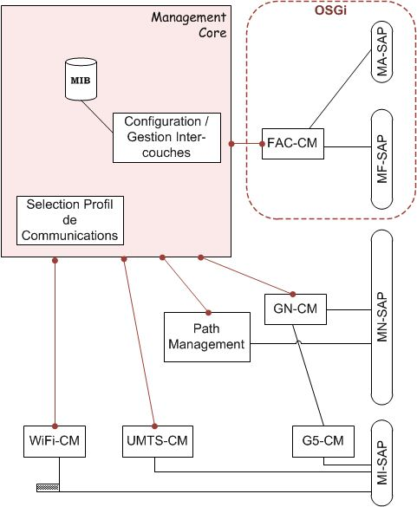
Detailed Schema

Slide 5
Interface to GN-CM and G5-CM
Partner : HITACHI
This interface is based on document [3].
G5-CM is interfaced through GN-CM to avoid accessing the modem directly
Messages and types supported
(“Event” actually means “Message”)
Location Event
1.0 - Update Location Event
State Event
4.0 Wireless State Event (used for G5-CM interface)
4.1 Network State Event
Configuration Event
3.1 Get Configuration Event (Request, Reply)
3.2 Set Configuration Event (Continuous)
3.3 Set Configuration Event (Bulk)
Primitives Header as in [3]

Slide 6
State Event Parameters
Wireless (per G5 channel)
Frequency, Bandwidth
Status, RSSI
Data rate, Transmit Power
Congestion level assessment
GeoNetworking
Status
Statistics

Slide 7
Configuration Parameters
ITS Parameter Name | Parameter Type | DESCRIPTION / VALUES
itsStationType | 0 | 1=UEV; 30=UBR;
itsStationSubType | 1 | 0=public, 1=private
itsGnLocalAddrConfMethod | 1000 | 0=auto, 1=managed
itsGnDefaultHopLimit | 1001 | Default Hop Limit (0-255)
itsGnMaxPktLifetime | 1002 | Upper Limit of Packet Lifetime (1-6300000) [ms]
itsGnMinPktRepetitionInterval | 1003 | Lower Limit of the Packet Repetition Interval [ms]
itsGnGeoBcastForwardingAlg | 1010 | 0: Unspecified, 1: Simple, 2 Advanced (optional)
itsGnGeoUcastForwardingAlg | 1011 | 0: Unspecified, 1: Greedy, 2: ETSI-CBF, 3: Revised-CB
itsGnTrafficClassRelevance | 1020 | 0-7 [High 0 <--> 7 Low]
itsGnTrafficClassReliability | 1021 | 0-3 [High 0 <--> 3 Low]
itsGnTrafficClassLatency | 1022 | 0-3 [Low 0 <--> 3 High]
itsGnCbfMinTTS | 1030 | Minimum time-to-send [ms]
itsGnCbfMaxTTS | 1031 | Maximum time-to-send [ms]
itsGnMaxCommRange | 1040 | Theoretical radio communication range [m]
itsGnDefTxPower | 1050 | TxPower [in 1dBm steps]
itsGnDefBitrate | 1051 | Bitrate [in Mbps -- 3, 4.5, 6, 9, 12, 18, 24, 27]
itsGnDefChannel | 1052 | Channel number [176, 178, 180]
itsGnDefPriority | 1053 | Priority [0-7]
itsGnDefChannelBW | 1054 | BandWidth [MHz]
itsGnCommProfiles | 1060 | Reduced Communication Profile Table (BTP-Type, CH number)

Slide 8
Interface to FAC-CM
Partner : ?? HITACHI ??
This interface extends document [3].
Primitives supported (“Event” actually means “Message”)
Configuration Event
3.1 Configuration Available Event
3.2 Get Configuration Event (Request, Reply)
3.3 Set Configuration Event (Continuous, Bulk)
Profile Selection Event
5.0 Select Profile Event (Request, Reply)
5.1 Get Profile Event (Request, Reply)
Primitives Header as in [3]

Slide 9
State and Configuration Parameters
Parameter Name | Parameter Type | DESCRIPTION / VALUES
ITS StationIdentifier,
Management Layer AID
supported versions of CAM and DENM
ITS Station type,
Vehicle Type,
publicVehicleType,
emergency ResponseType,
CAM btpPort
DENM btpPort
Station status,
Available exchange profile Table
Communication Profiles Table
Priorities and traffic classes Table
Current Position (set of parameters including latitude, longitude, elevation)
Speed (set of parameters)
authorizedStation
enabledInformationCentricForwarding
LDM garbageCollectionInterval

Slide 10
Profile Events Parameters
Request
Transaction Number
Application Id (key to Exchange Profile Table)
Message AID (or Flow identifier)
Reply
Transaction Number
Communication Profile ID

Slide 11
Interface to Path Management
Partner : INRIA
This interface extends document [3].
Messages and types supported
(“Event” actually means “Message”)
State Event
4.1 Network State Event
Configuration Event
3.1 Get Configuration Event (Request, Reply)
3.2 Set Configuration Event (Continuous)
3.3 Set Configuration Event (Bulk)
Primitives Header as in [3]

Slide 12
State Event Parameters
UDP
Source Ports in operation
Destination Ports in operation
TCP
Source Ports in operation
Destination Ports in operation
IPv6
Packet payload size,
delay,
latency,
jitter,
number of hops to destination

Slide 13
Configuration Parameters (Table of paths)
Parameter Name | Parameter Key | DESCRIPTION / VALUES
Pathid
Locator
Anchor
Next hop
Group id
Path reachability
Path capabilities
Path status
Start time
End time

Slide 14
Interface to UMTS-CM
Partner : FRANCE TELECOM
This interface extends document [3].
Messages and types supported
(“Event” actually means “Message”)
State Event
4.0 Wireless State Event (used for UMTS-CM interface)
Primitives Header as in [3]

Slide 15
State Event Parameters
3G modem
Interface Status (Connected/Not connected),
RSSI, BER, RSCP, ECN0,
LTE: RSRQ, RSRP,
MBR DL, MBR UL, PER GeoNetworking
Status

Slide 16
Interface to WiFi-CM
Partner : ?? FRANCE TELECOM ??
This interface extends document [3].
Messages and types supported
(“Event” actually means “Message”)
State Event
4.0 Wireless State Event (used for WiFi-CM interface)
Primitives Header as in [3]

Slide 17
State Event Parameters
WiFi Modem
Interface Status (Connected/Not connected),
Channel,
Data Rate,
RSSI,
PER,
Packet Transfer Delay

